Slide 1
PERSONAL
GROWTH and
INVOLVEMENT PROGRAM
PGI
Updated October 2014

Slide 2


What Is P.G.I. ?
An opportunity for you to
1. Learn more about Optimist International
2. Become more involved with the Club
3. Enhance your leadership skills
4. Etc.

Slide 3


WHY P.G.I. WAS DEVELOPED
Create a standard of a good Optimist Member
Offer every member an opportunity to receive personal benefits when joining an Optimist Club
Make sure every Club offers every member the challenges they need to become a better leader.

Slide 4
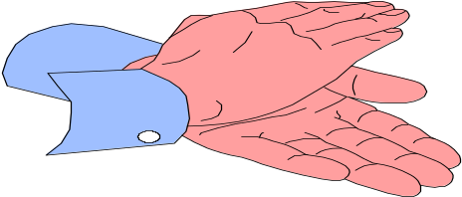

Why PGI Developed continued
To give proper recognition to every member, based on clear challenges.
Promote a better understanding of Optimist International at every level of the organization.
Help everyone promote a philosophy of Optimism
Help Club President achieve a successful year.

Slide 5

10 Levels of Involvement & Recognition
Level X Lapel Pin
Level IX Yellow
Level VIII Orange
Level VII GOLD
Level VI PURPLE
Level V BLACK
Level IV BLUE
Level III BURGUNDY
Level II GREEN
Level I BRONZE

Slide 6

ELEMENTS OF PGI
KNOWLEDGE OF OI
GROWTH
ACTIVITIES
ATTENDANCE
COMMUNICATION
PERSONAL GROWTH

Slide 7
LEVEL I - BRONZE
ATTENDANCE:
ACTIVITY:
KNOWLEDGE OF THE ORGANIZATION
SELF-DEVELOPMENT
COMMUNICATION
6 meetings/activities
1 Club Service Activity
Learn 5 Purposes & founding of OI
Short presentation on “How Optimism Can Make World Better”
Read resume of new member

Slide 8
LEVEL II - GREEN
ATTENDANCE:
ACTIVITY:
GROWTH:
KNOWLEDGE OF THE ORGANIZATION
SELF-DEVELOPMENT
COMMUNICATION
3 more meetings
Serve on a Committee
1 New Member
Know OI, district, Zone & Club structures
Short presentation on “How Optimism has Enriched my Life”
Promote attendance for month

Slide 9
LEVEL III- BURGUNDY
3 more meetings/activities
Chair a Committee
1 New Member
Read book “Power of the Creed”
Complete a Skills Development Module
Help assemble a CPA summary
ATTENDANCE:
ACTIVITY:
GROWTH:
KNOWLEDGE OF THE ORGANIZATION
SELF-DEVELOPMENT
COMMUNICATION

Slide 10


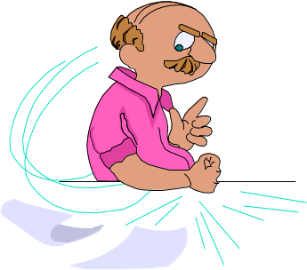

PERSONAL/PROFESSIONAL GROWTH MODULES
Public Speaking
Managing Change
Effective Time Management
Creative Problem Solving
Choosing Optimism As a Philosophy of Life
Orientation to Optimism for New Members
Parliamentary Procedure
Team Building Mentoring
Leadership: Styles & Profiles

Slide 11
LEVEL IV- BLUE
2 more meetings & 1 inter-club visit
Another club activity
1 New Member
Know President of OI, VP, Gov. and Lt. Gov.
Present “Best Times I’ve shared w/ youth”
Visit or call missing member - Pres. Appt.
ATTENDANCE:
ACTIVITY:
GROWTH:
KNOWLEDGE OF THE ORGANIZATION
SELF-DEVELOPMENT
COMMUNICATION

Slide 12
LEVEL V- BLACK
ATTENDANCE:
ACTIVITY:
GROWTH:
KNOWLEDGE OF THE ORGANIZATION
SELF-DEVELOPMENT
COMMUNICATION
2 more meetings & Zone or District meeting
Another Club activity
1 New Member
Creed from memory
2nd Skills Development Module
Article on Club activities

Slide 13
PERSONAL/PROFESSIONAL GROWTH MODULES
Public Speaking
Managing Change
Effective Time Management
Creative Problem Solving
Choosing Optimism As a Philosophy of Life
Orientation to Optimism for New Members
Parliamentary Procedure
Team Building Mentoring
Leadership: Styles & Profiles

Slide 14
LEVEL VI- PURPLE
ATTENDANCE:
ACTIVITY:
GROWTH:
KNOWLEDGE OF THE ORGANIZATION
SELF-DEVELOPMENT
COMMUNICATION
2 more meetings &/or activities
Another Club activity
1 New Member
5 min. presentation on an Optimist program
Educate new member - purposes & benefits
Promote Club activity w/in community

Slide 15
LEVEL VII- GOLD
ATTENDANCE:
ACTIVITY:
GROWTH:
KNOWLEDGE OF THE ORGANIZATION
SELF-DEVELOPMENT
COMMUNICATION
2 meetings & District Convention
Organize New Activity
Help build new Club
10 min. presentation on OI to Club members
Serve as Club officer
Send article to “The Optimist”

Slide 16
LEVEL VIII- ORANGE
ATTENDANCE:
ACTIVITY:
GROWTH:
KNOWLEDGE OF THE ORGANIZATION
SELF-DEVELOPMENT
COMMUNICATION
2 Consecutive District meetings
Serve on a District Committee
New Club Follow Up program
Attend New Club Building Seminar
Third Skills Dev. Module
Assist member in Level I

Slide 17
LEVEL IX- YELLOW
ATTENDANCE:
ACTIVITY:
GROWTH:
KNOWLEDGE OF THE ORGANIZATION
SELF-DEVELOPMENT
COMMUNICATION
4 More District meetings
Serve on 2nd District Committee
2 New Members
Make Club or Zone presentation for District Committee
Fourth Skills Dev. Module
Assist member in Level IV

Slide 18
LEVEL X- LAPEL PIN
Presented at a District Meeting
Recognized by International President at the International Convention
ATTENDANCE:
ACTIVITY:
GROWTH:
KNOWLEDGE OF THE ORGANIZATION
SELF-DEVELOPMENT
COMMUNICATION
2 More District meetings or 1 Intl. Convention
District Committee Chair or Officer
“Builder of Excellence”
Present “Orientation” Module for new Members
3 Training Sessions at District or International
Assist member in Level VII

Slide 19

WHEN FINISHED - ATTENDANCE
Attended 20 club meetings/activities
One inter-club visit
One District / Zone Meeting
8 District Conventions/Meeting
1 International Convention

Slide 20



COMPLETION - ACTIVITIES
Participate in 4 Club activities
Serve on one Committee
Chair one Committee
Create, organize & present a new activity to Board
Serve on 2 District Committees
Chair a District Committee

Slide 21
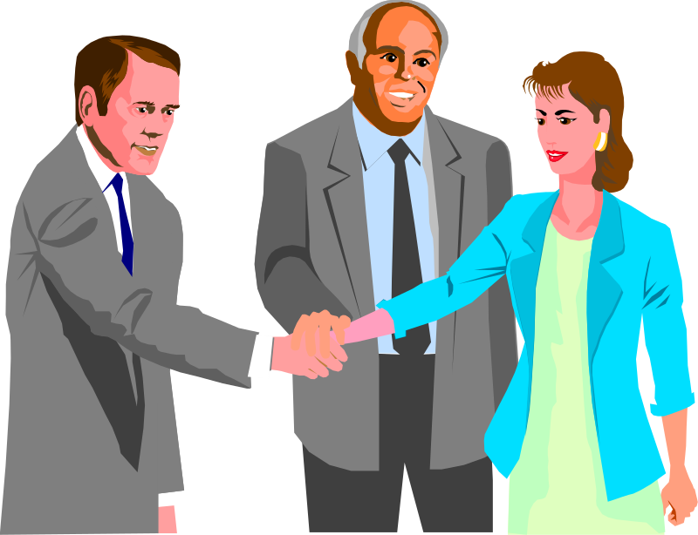

COMPLETION - GROWTH
Total of 7 New Members
One New Club (Possibly 3)
Follow- Up Program
Builder of Excellence

Slide 22

COMPLETION - Knowledge of OI
5 Purposes of OI and its founding
Structure of OI
“Power of the Creed”
Names of OI President, VP, Governor and Lt. Gov.
Creed
3 Presentations on OI and Programs
Attended New Club Building Seminar
Orientation Program

Slide 23

COMPLETION - SELF DEVELOPMENT
3 Presentations
4 Skills Development Modules
Teach a New Member the Purposes & Benefits of Optimist Clubs
Serve as club officer
3 Training Courses

Slide 24

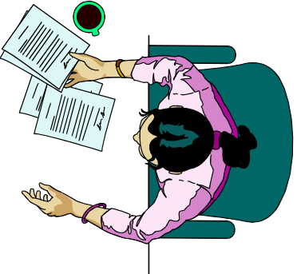
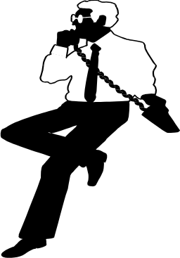

COMPLETION - COMMUNICATION
Read resume of new member
Promote club meeting attendance
Help assemble a CPA summary
Visit/call a missing member
2 written articles
Promote club activity
Assist 1 – 3 members w/PGI

Slide 25

Certification & Effective Dates
LEVELS I - VII
Certification must be registered/certified by Secretary-Treasurer, President or Club Director of Personal Growth
Effective Date:
October 1, 1994

Slide 26

Certification & Effective Dates
LEVELS VIII - X
Certification must be registered/certified by Governor or Lt. Governor
Effective Date:
October 1, 2000

Slide 27

NEW MEMBERS
What employer would not want employees to learn/enhance:
Networking
Research Skills
Public Speaking
Advertising
Writing Skills
Leadership
Self-Motivation

Slide 28
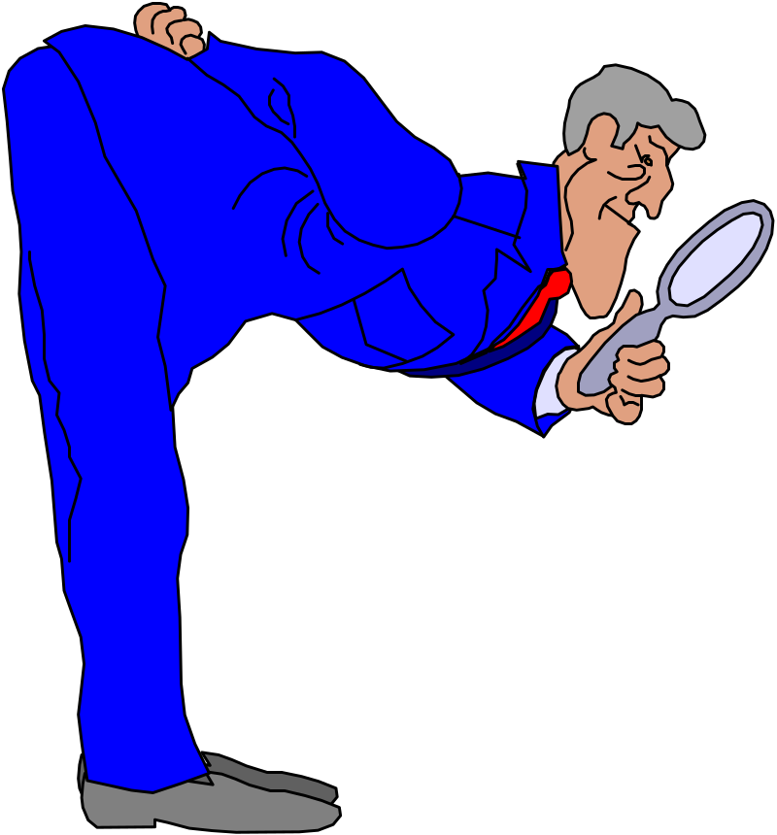
What Do I Need to Do Now?
Review Passport and determine what things you have completed
Get them certified
Get in touch with potential employers
Let Membership Committee help

Slide 29


Georgia District Personal Growth and Involvement
 |  | straitl@cox.net |  |  | Document1 | Sep 1
Kathy Forster, Chairman
337 Meadows Dr
Loganville, GA 30052
kforster428@gmail.com
256-371-0062 Cell
Reporting Dates:
5th of October
5th of January
5th of April
5th of July
Send your PGI update Reports via mail or email to the District PGI Chairman.
.

Slide 30
OI PGI Program Information
Additional P.G.I. information,: P.G.I. section of the Optimist Leaders website: http://www.optimistleaders.org/LeadershipInfo/PersonalDevelopment/PGIProgram.pdf
Stephanie Monschein Director, Leadership Dept.
stephanie.monschein@optimist.org
1-(800) 500-8130, ext. 261.
Do not send your Passports to the OI office.
Send your PGI update Reports to the District PGI Chairman.

Slide 31

P.G.I. - QUESTIONS
THE END

